Slide 1


AUTOMATIC FEEDBACK GENERATOR FOR STUDENT ANSWERS GUIDE: Mr.ramesh dadi
BATCH - 91
2003a52079 P.Shravya
2003a52016 S.Sai Siddhartha
2003a52084 V.Akshaya
2003a52010 K.Sahith Reddy
2003a52116 Md.Abdul Muqtadir

Slide 2

CONTENTS
Abstract
Introduction
Problem Statement
Existed system
Proposed System
Model Architecture
Result Analysis
Conclusion
Future Scope
References

Slide 3

ABSTRACT
In the field of education, punctual and constructive feedback is paramount for student growth and academic success. This research paper introduces an innovative approach to feedback generation for student answers, using advanced natural language processing (NLP) techniques. The primary objective is to develop an intelligent system capable of assessing and providing feedback on student responses to various academic tasks. The system utilizes a pre-trained NLP model, adapted to the refinement of academic writing, to evaluate key criteria such as clarity, relevance, coherence, and originality. To train the model, a diverse dataset of well-crafted responses was gathered ensuring representation across different disciplines and writing styles. The feedback generated is not only based on correctness but also provides insights into areas of improvement

Slide 4

INTRODUCTION
As educators strive to provide personalized guidance to a diverse range of learners, technology emerges as a pivot in meeting this pedagogical challenge.
This project embarks on a journey into the realm of educational technology, focusing on the development and implementation of an Automatic Feedback Generator designed to enhance the assessment and learning experience for students.
In response to this dilemma, our research endeavors to bridge the gap between the need for swift feedback and the desire for meaningful, constructive insights.
By employing advanced natural language processing (NLP) algorithms, the system aims to analyze input data comprehensively and generate constructive feedback that is both accurate and tailored to individual needs.
This project addresses this limitation by introducing automation, thereby ensuring that feedback is delivered promptly, consistently, and in a manner that aligns with the specific requirements of the learner or individual receiving feedback

Slide 5
.

Slide 6
PROBLEM STATEMENT
In traditional educational settings, providing timely and constructive feedback on student assessments is a time-consuming task that often demands significant effort from educators.
As class sizes grow and the demand for online education increases, the need for an efficient and scalable solution to deliver personalized feedback becomes paramount.
The challenge lies in developing a system that can automatically generate accurate and insightful feedback for a diverse range of student answers across various subjects and assessment types.
Current automated feedback systems often lack the nuance and specificity required to address individual student needs, leading to generic responses that may not effectively guide student learning.

Slide 7

EXISTED SYSTEM
More recent work has begun to use large-scale pre-trained language models such as BERT (DEVLIN, 2019), BART (LEWIS, 2020) and GPT-2 (RADFORD, 2019), for giving feedback. These language models use an attention mechanism to learn long-term dependencies and are pre-trained on large unsupervised generic corpora to reduce the need for labeled data.
(Olney, 2021) attempted to generate elaborate feedback for student responses using the ELI5 model (FAN) and got good results.
Data-driven methods generate feedback by implicitly learning mappings from student work to expert feedback using deep learning algorithms (DEEVA, 2021). For example, (LU, 2021) implemented several models, including CNN, CNN+LSTM, and CNN+Bi-LSTM for generating textual feedback on student essays.

Slide 8

PROPOSED SYSTEM
The Automatic Feedback Generator For Student Responses system is designed to streamline the feedback process for educators by automating the evaluation of student answers and providing personalized, constructive feedback.
The system employs a combination of advanced algorithms, natural language processing (NLP), and machine learning techniques to achieve accurate and insightful assessments.
Automated feedback can provide a more objective assessment of student responses, minimizing the impact of subjective biases that might arise in human grading.
In this we used GPT-2 to capture the contextual information, relationships between words, and overall semantics of the input text.
This model of text-to-text approach offers flexibility and simplicity when adapting the model to different tasks and can be used in different domains related to text

Slide 9
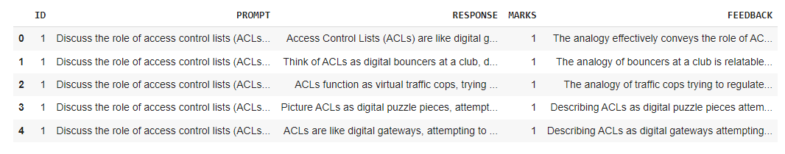
DATASET
S.No. | Attribute | Data Type
1 | ID | Numeric(integer or float)
2 | PROMPT | Text/String
3 | RESPONSE | Text/string
4 | MARKS | Numeric(integer or float)
5 | FEEDBACK | Text/String

Slide 10

MODEL
Generative Pre-trained Transformer 2 (GPT-2) stands as a significant achievement in the field of natural language processing, crafted by OpenAI as the second iteration in their series of GPT models. Unlike its predecessor, GPT-1, GPT-2 was trained on an extensive dataset comprising 8 million web pages..
This design greatly enhances parallelization and surpasses previous benchmarks set by models based on recurrent neural networks (RNNs), convolutional neural networks (CNNs), and long short-term memory (LSTM) networks.
GPT-2 is based on the Transformer model, which utilizes self-attention mechanisms to process input sequences in parallel, providing a powerful framework for natural language understanding and generation.
Unlike BERT, which has both encoder and decoder components, GPT-2 uses a decoder-only structure. This design is particularly suited for text generation, as it predicts the next word or token based on the preceding context.

Slide 11
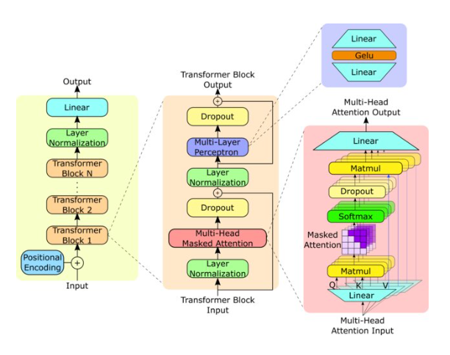
MODEL ARCHITECTURE

Slide 12
RESULT ANALYSIS
We used established metrics such as ROUGE and BLEU scores to assess the quality of the generated feedback. ROUGE measures the overlap between the model-generated feedback and human-generated reference feedback, focusing on recall-oriented evaluation.
BLEU, on the other hand, evaluates the similarity between the model-generated feedback and reference feedback based on n-gram precision.
Our feedback generation system achieved ROUGE scores ranging from 0.6 to 0.7 and BLEU scores within the same range, indicating a high level of correspondence between the model-generated feedback and human-generated reference feedback

Slide 13
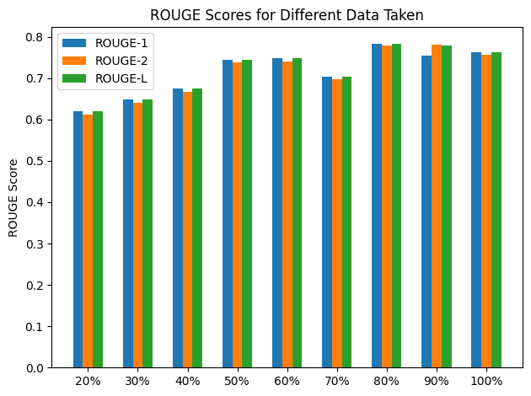
Table : ROUGE Score values .
s.no | Data taken | ROUGE-1 | ROUGE-2 | ROUGE-L
1 | 20% | 0.6204778176369085 | 0.612545371637027 | 0.6204778176369085
2 | 40% | 0.6745563661013575 | 0.6670957290172047 | 0.6745563661013575
3 | 50% | 0.7432654193856669 | 0.7369402346643726 | 0.7432654193856669
4 | 60% | 0.7471514025477571 | 0.7407687154262496 | 0.7471514025477571
5 | 70% | 0.7043232676220402 | 0.6972569753944899 | 0.7043232676220402
6 | 80% | 0.7836477698828341 | 0.7778276078276078 | 0.7836477698828341

Slide 14
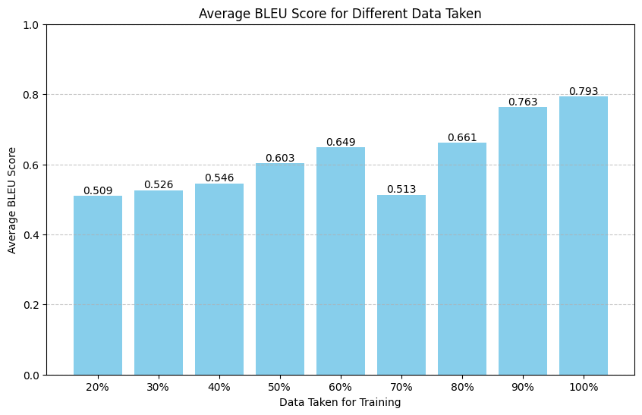
BLEU Scores

Slide 15

CONCLUSION
In this project, the implementation of natural language processing techniques for feedback generation in assessing student answers has showcased significant advancements and promising outcomes. The successful fine-tuning of language models with domain-specific content has wide-reaching implications.
These developments hold the potential to significantly improve educational support systems, providing students with personalized and detailed feedback to augment their learning experiences.
The project's outcomes suggest a pathway for more automated and efficient assessment of student answers across diverse subjects, potentially reducing the workload for educators and speeding up the feedback loop for students

Slide 16

FUTURE SCOPE
The future scope for the project on automatic feedback generation for student responses using NLP involves leveraging domain-specific content, like textbooks, slides, and lecture notes, to fine-tune language models.
Transfer learning, a technique for adapting a general-purpose neural network to a specific task, could be applied in this context to refine the model for evaluating student responses.
Customizing these models can significantly enhance the assessment of exercises that demand specialized domain knowledge.
Domain-Specific Model Refinement: Incorporating educational materials into the training process can create more specialized language models. These models will be better equipped to understand and evaluate student answers in a specific subject area, potentially improving the accuracy and depth of feedback.

Slide 17
REFERENCES
1.Adailton Ferreira and Marcacini, R. M. (2021). RE-BERT: Automatic Extraction of Software Requirements from App Reviews Using BERT Language Model.
https://doi.org/10.1145/3412841.3442006
2. Burrows, S., Gurevych, I. & Stein, B. The Eras and Trends of Automatic Short Answer Grading. Int J Artif Intell Educ 25, 60–117 (2015).
https://doi.org/10.1007/s40593-014-0026-8
3.Chatterjee, S. B. Adoption of artificial intelligence in higher education: a quantitative analysis using structural equation modelling. .
4.DEEVA, G. B. (2021). automated feedback systems for learners: Classification framework, challenges and opportunities.
5.DEVLIN, J. C.-W. (2019).FAN, A. J. Eli5: Long form question answering.
6.Jan Philip Bernius, S. K. (2022). Machine learning based feedback on textual student answers in large courses,
https://doi.org/10.1016/j.caeai.2022.100081
(https://www.sciencedirect.com/science/article/pii/S2666920X22000364)
7.Jeffrey Pennington, R. S. GloVe:Global Vectors for Word Representation.
8.Karnalim, O. a. (2022). Educating Students about Programming Plagiarism and Collusion via Formative Feedback.
9.Kok, C. a. (2023). Comb: Giving Feedback to Short Answer at Scale with Human-in-the-Loop Rubric Creation.
https://doi.org/10.1145/3573051.3596195
10.Lawrence, R. a. (2023). Evaluation of Submission Limits and Regression Penalties to Improve Student Behavior with Automatic Assessment Systems.
https://doi.org/10.1145/3591210

Slide 18

.

